Slide 1
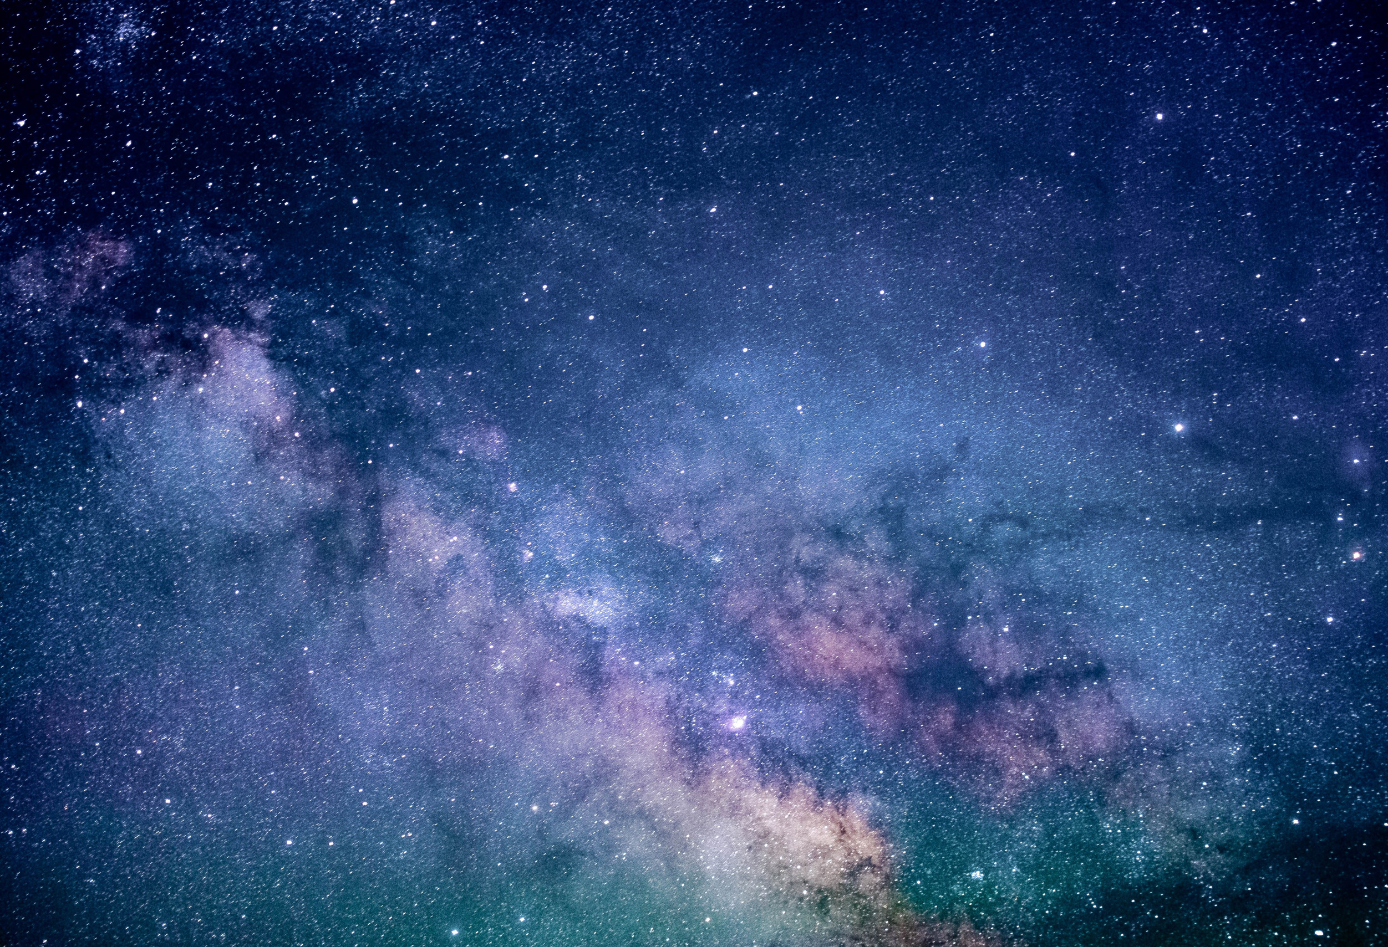

Develop the Oracle of DSCOVR
By Solar Xplorers

Slide 2


Meet the Solar Xplorers
Manar El Bagoury
Data Science Intern @ Synapse Analytics
Nour Kamaly
Machine Learning Engineer @ Dell Technologies
Participant & Local Winner in NASA Space Apps Cairo 2022

Slide 3
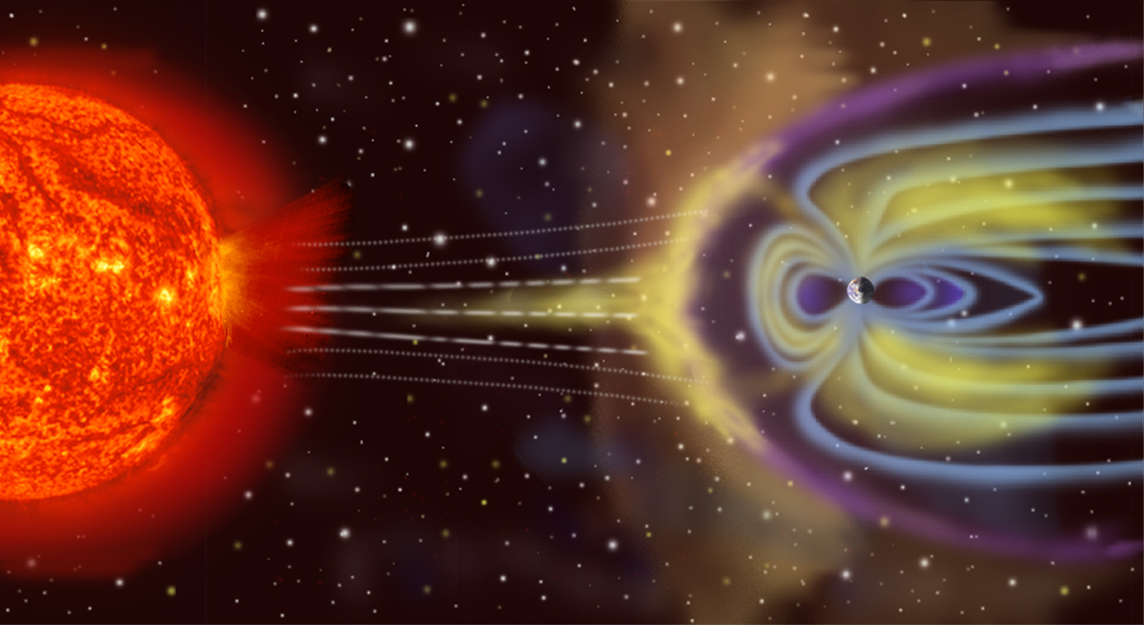
Problem Definition
- Geomagnetic storms on Earth are a menace to many modern technologies, particularly GPS satellite systems and electrical power grids. These storms occur when strong gusts of wind or storms from the Sun traverse interplanetary space and reach Earth, deforming Earth's magnetic field and showering particles into Earth's magnetic poles. These storms are notoriously difficult to predict. Even when solar flares and eruptions are observed that may cause a geomagnetic storm, the travel time for material to reach Earth could be anywhere from about two to four days (or it could miss Earth entirely)

Slide 4
Solution Pipeline
Data Integration
There is multiple data sources, we agreed on using 2; NOAA Space Weather Prediction Center: Real Time Solar Wind, and the experimental data repository that contains data for the past 6 years
The analysis of time series patterns in the previous mentioned 2 datasets
Preprocessing
Feature extraction, feature engineering and imputing null values in the data
Web Interface Design
Using the selected model for real-time prediction in a publicly available web interface
Experimentation using 3 time series models: ARIMA, LSTMs, and Transformers
Data Analysis
Modeling

Slide 5
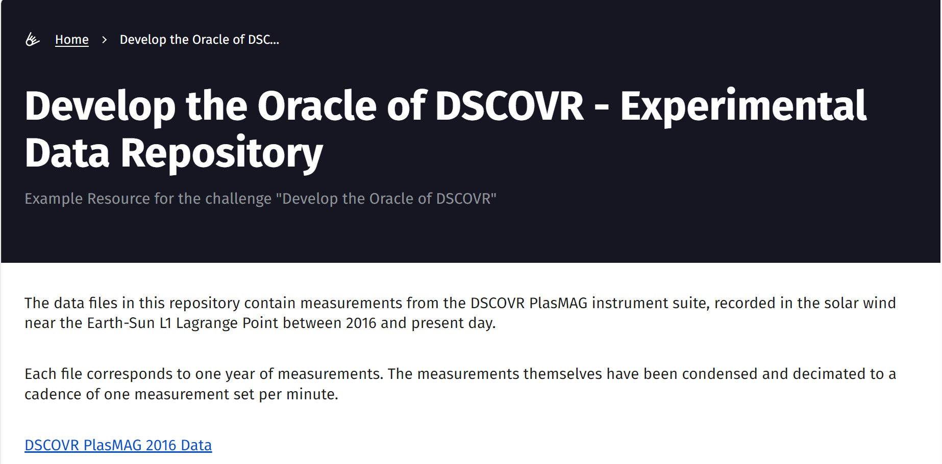
Data Integration
- This data is spanned across 6 years, and is sampled at a reading per minute, resulting in 283,680
readings per year, that is more than enough to train a deep learning model

Slide 6
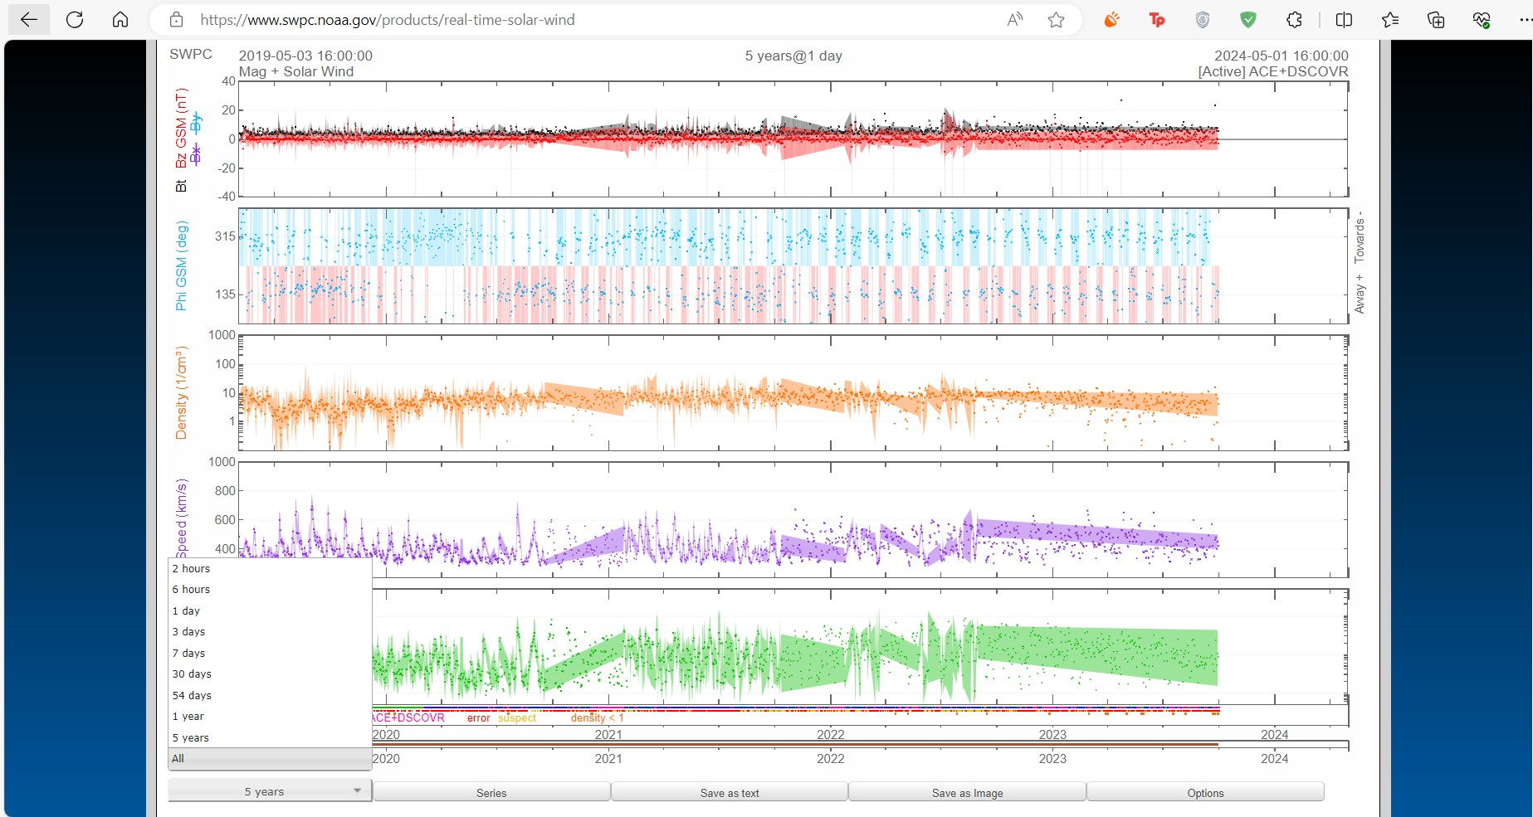
- The NOAA Space Weather Prediction Center: Real Time Solar Wind data is present in many frequencies and
has different features than the other dataset, experiments need to be run against both dataset to determine which
dataset has more potential

Slide 7
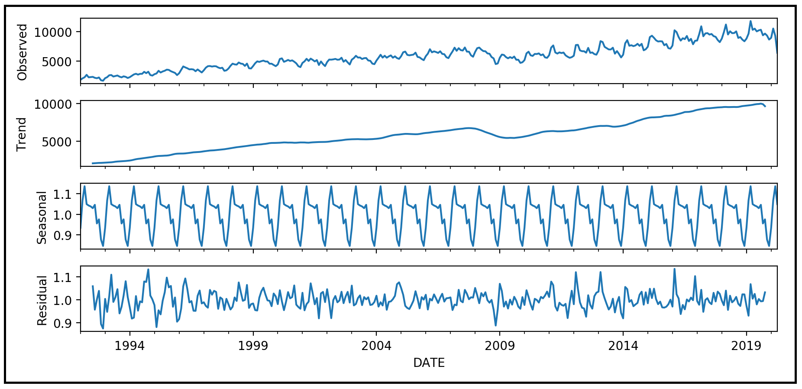
2. Data Analysis
- Time series data are often composed of trends, seasonality, and residuals, how often does
geomagnetic storms occur ?
- Is there an obvious pattern in the data ?

Slide 8
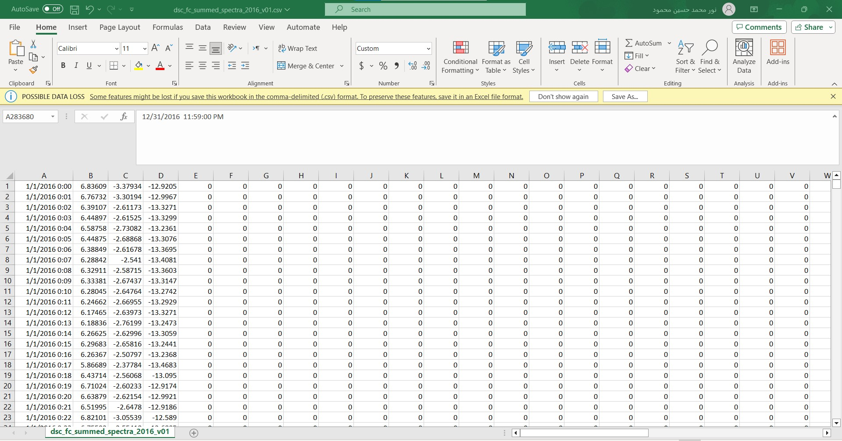
3. Preprocessing
- Filling null values using KNN Imputer
- Determining feature importance using statistics and probability
- Finding outliers (are they important ? Or is it better to remove them ?)

Slide 9
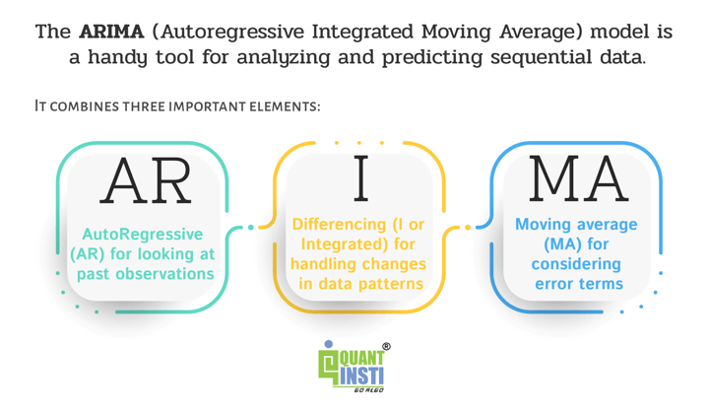
4. Modelling
- In any pattern recognition problem before trying the more computationally complex deep learning models, we usually do a baseline machine learning model. Since our problem is a time series forecasting problem, we thought that we could first try an ARIMA model that is a simple statistical model that determines the future value of a variable from its past values. Using the ACF and the PACF statistical tests, we can determine how many past values we should use to predict the future value.

Slide 10
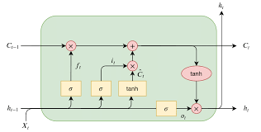
- If ARIMA failed, we would use an LSTM architecture with a sliding window. LSTMs have been proved to
work better than ARIMA in time series forecasting

Slide 11
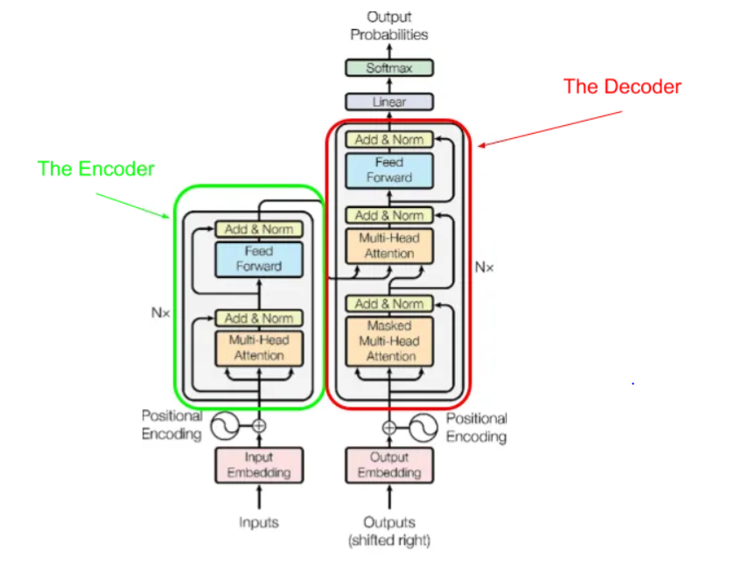
- We are also going to experiment with the transformer architecture implemented in the research paper
“Attention is All You Need”, as it was a revolutionary architecture in the deep learning world

Slide 12
5. Interactive Web Interface
- After the experimentation phase and deciding the most accurate machine/deep learning model that is able to precisely tell when w geomagnetic storm will occur and the severity of it, the model will be deployed in the backend of an open-source web interface

Slide 13
Thank you very much!

